Slide 1
Nagarathars Fund Empowering Entrepreneurs through structured financing
Image

Slide 2
Nagarathars Fund
Explore the possibilities of setting up an exclusive fund called “ N.Entrepreneurs’ Fund” to encourage talented and able
Nagarathars to enter and expand in their business and entrepreneurial capabilities.
Arrange and conduct deliberations and discussions with bankers/investment professionals/venture capitalists and find a more appropriate method of establishing such a “Fund” .
Arrange Road Shows along with Fund Managers/leaders in all International/Indian Main cities where investible Nagarathar communities reside/domicile to facilitate setting up “the Fund”.
This will help bring credibility to the IBCN initiatives as it would be looked upon as one of the constructive and useful step forward in bringing back the entrepreneurial capabilities of Nagarathars to the world focus again.

Slide 3
How EHC can help Investors and Businesses?
Help the community and get rewarded
Easy access to funding during any stage of the business
Funding and business advisory services to reach the full potential
Diversify risks through various options to choose

Slide 4
In a nutshell
Investors | Businesses
Manage risks through diversification Variety of investment choices Build a portfolio that fits your investment objectives Hassle free fund management Complete control over your investment Exit root through Over-the-counter transactions (OTC) Be part of the community growth with rewards | Easy access to finance Various financing options at each stage of the business including seed level Entrepreneurial support including help to improve financial acumen Convenient options to reach EHC saving you time and effort

Slide 5
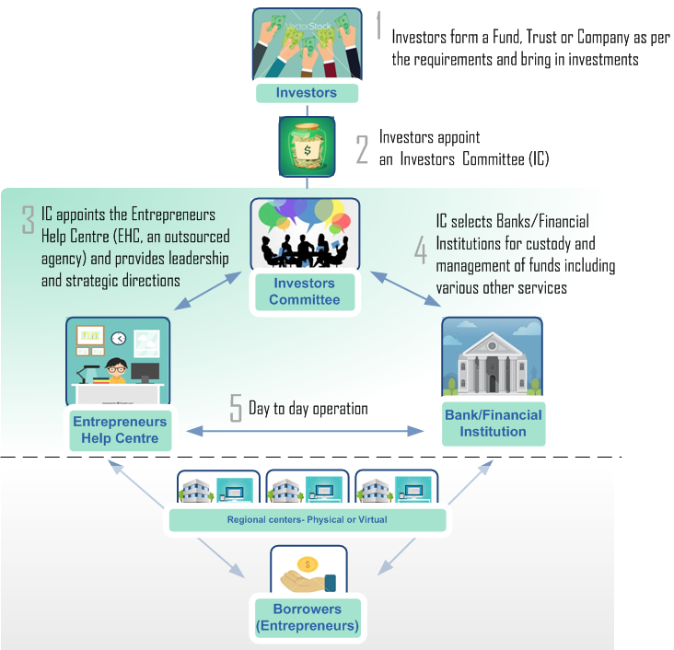
Proposed structure

Slide 6
How it works?
Key stages

Slide 7
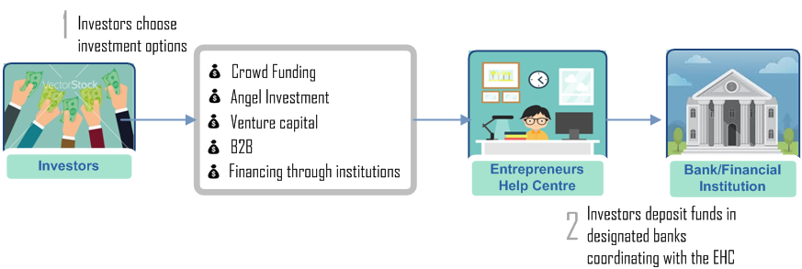
How it works?
1. Investment avenues

Slide 8
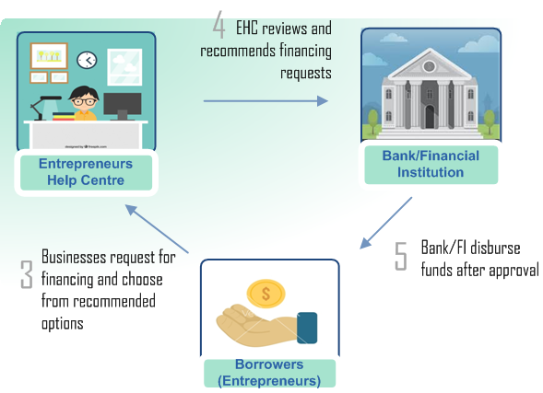
How it works?
2. Lending structure
a. Investment avenues - Crowd funding, Angel investment, Venture capital and Financing

Slide 9
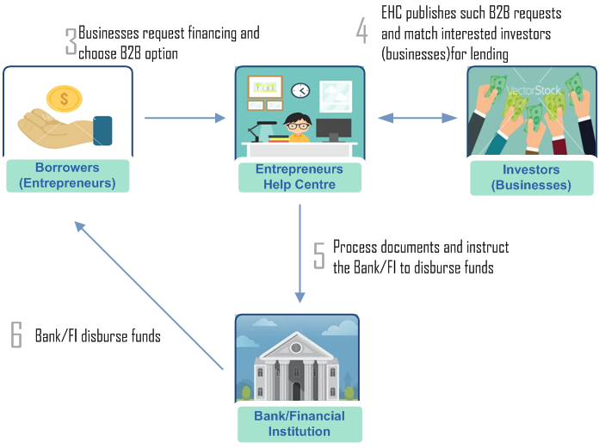
How it works?
2. Lending structure
b. Investment avenues – Business-to-business

Slide 10
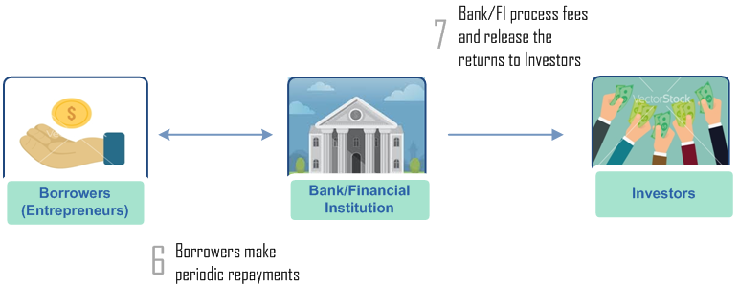
How it works?
3. ROI
a. Investment avenues - Crowd funding, Angel investment, Venture capital and Financing

Slide 11
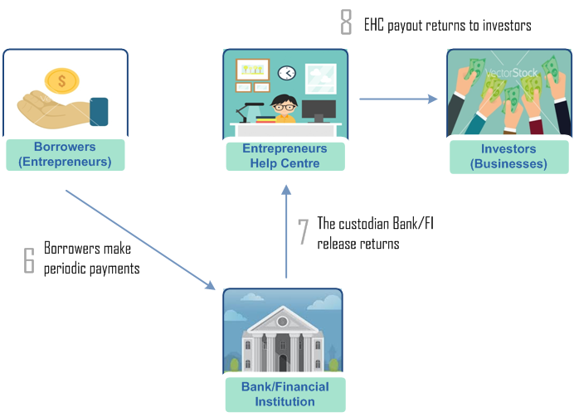
How it works?
3. ROI
a. Investment avenues – Business-to-Business

Slide 12
Q&A
 | India | Singapore
Legal status to run An investment network Services associated with deposits and lending Legal status to manage and operate a fund Company/Fund Formation cost Formation cost reimbursement method Corporate Governance requirements Criteria to form the IC and its obligations Participation of Independent Directors, Domain experts Auditors Fund - Domiciled jurisdiction Currency restrictions Min-Max caps on Investments Investor profile (Individual or Business) Restrictions on types of Investors (Local, Foreign, NRIs, PEP etc) Taxation Maturity of Alternative Financing schemes in the given countries Technology readiness for each type of financing options Specific restrictions from Banks/Financial Institutions

Slide 13
Next steps?

Slide 14
Thank you!
Investing in any business involves risks, including illiquidity, lack of dividends, loss of investment and dilution, and it should be done only as part of a diversified portfolio. This proposal is targeted exclusively at investors who are sufficiently sophisticated to understand these risks and make their own investment decisions, based on their knowledge, experience and financial capacity. You will only be able to invest through this once you are registered and deemed suitable for this type of investment. Investments can only be made on the basis of information provided in the pitches by the businesses concerned, full details of which are available to authorized Investor Members only. The Company takes no responsibility for this information or for any recommendations or opinions made by the businesses. Communications made by The Company, through this document or any other medium, are not intended to be promotions of any individual investment opportunity, not do they constitute financial, legal or tax advice. Further, nothing on this proposal shall be construed as an offer to sell, or a solicitation of an offer to buy, any security to any person in any jurisdiction to whom or in which such offer, solicitation or sale would be unlawful under the laws of that jurisdiction.

